Slide 1

MINI PROJECT PRESENTATION
SLR & SLC
TOPIC DOMAIN – HEALTHCARE
Presentation by: (Group 13)
NARASHIMMHAN R S
SINGH RAHUL SOMESHCHANDRA
LOKESH
DUDI SUBHASH
ANIKET VERMA

Slide 2

INTRODUCTION TO PROBLEM STATEMENT
Stroke is a severe cerebrovascular disease caused by an interruption of blood flow from and to the brain. As a direct consequence of this interruption, the brain is not able to receive oxygen and nutrients for its correct functioning. The other way around, the brain is not able to drain and expel through blood vessels all of its waste, like dead cells. In a question of minutes, the brain is in a critical condition as brain cells will imminently begin to die. The American Stroke Association indicates that stroke is the fifth cause of death and disability in the United States. For this reason, stroke is considered a severe disease and has been the subject of extensive research, not only in the medical field but also in data science and machine learning studies.
Given the patients’ clinical parameters, we are here to predict whether or not they will suffer from brain stroke.

Slide 3
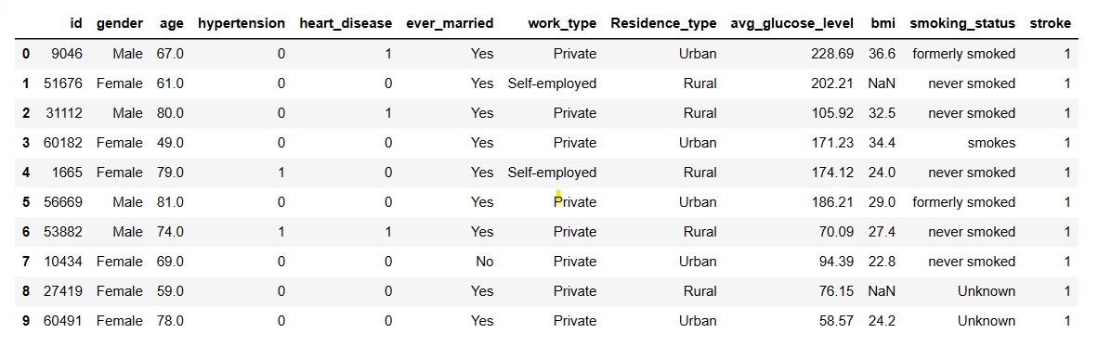
DATASET DESCRIPTION
The dataset used in this article contains 5110 records of patients. Each patient has 12 columns each referring to a concrete attribute.
1. Id - Unique Id
2. gender
3. age
4. hypertension - Binary Feature
5. Heart_disease - Binary Feature
6. Ever_married - Has the patient ever been married
7. Work_type - Work type of a patient
8. Residency_type - Residency type of patient
9. avg_glucose_level - Average Glucose level in the blood
10. bmi - Body mass Index
11. smoking_status - Smoking status of the patient
12. stroke - stroke event

Slide 4
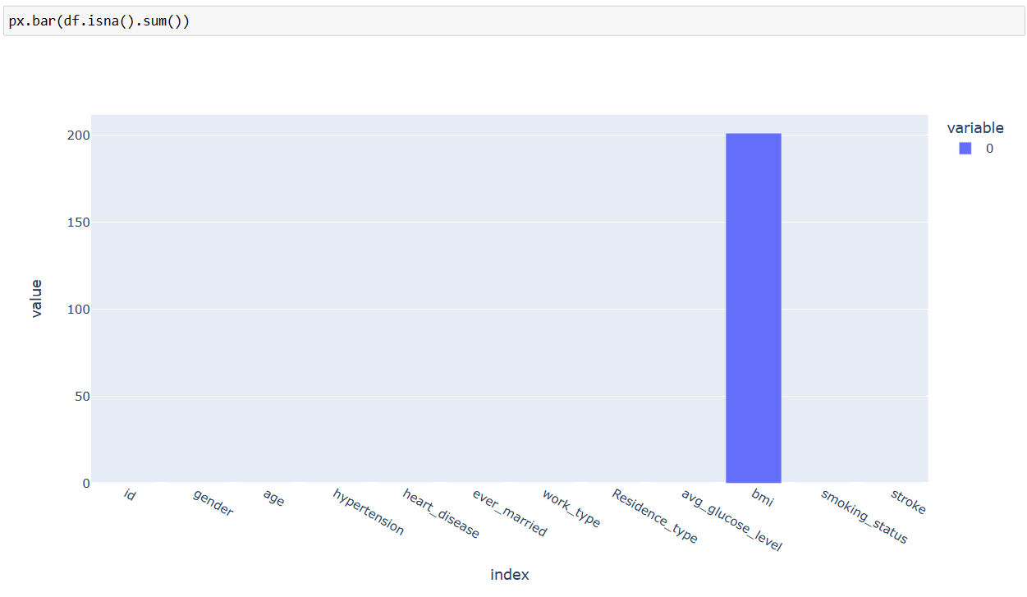


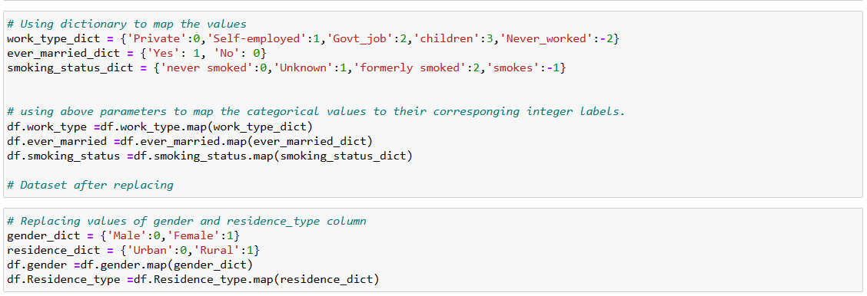
DATASET CLEANING STEPS
BMI column has 201 missing values.
Imputed through median value (presence of outliers).
Replaced gender column values.
Removed id column.
Converted categorical instances to numerical.

Slide 5
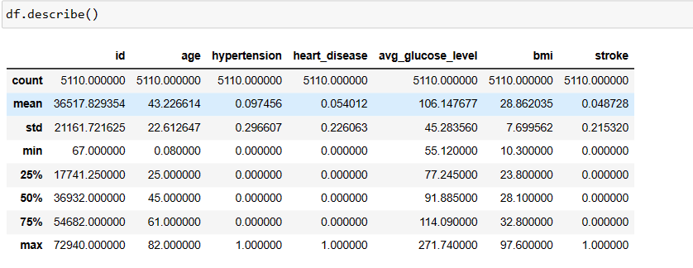
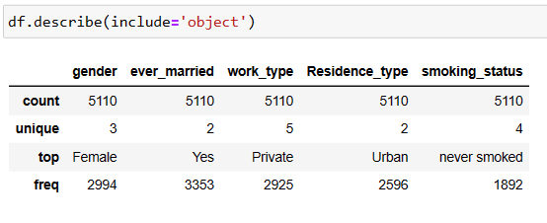
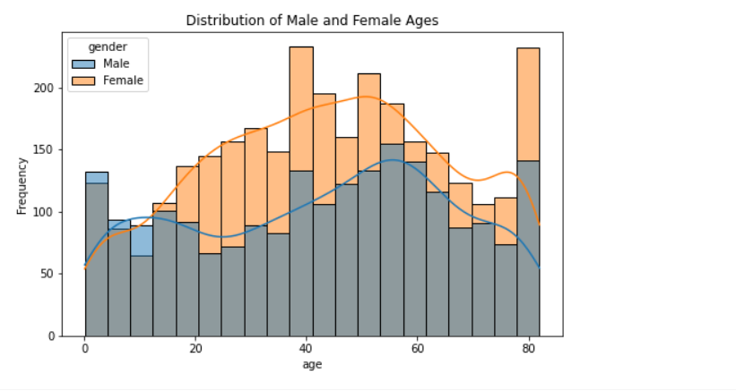
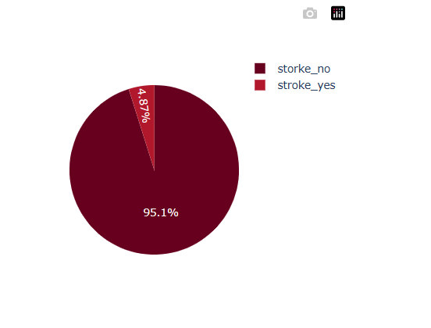
DATA VISUALIZATION
Age, avg_glucose_level and bmi column are right skewed.
Male and Female follow multimodal distribution wrt age.
Observations of not having a stroke are more.

Slide 6
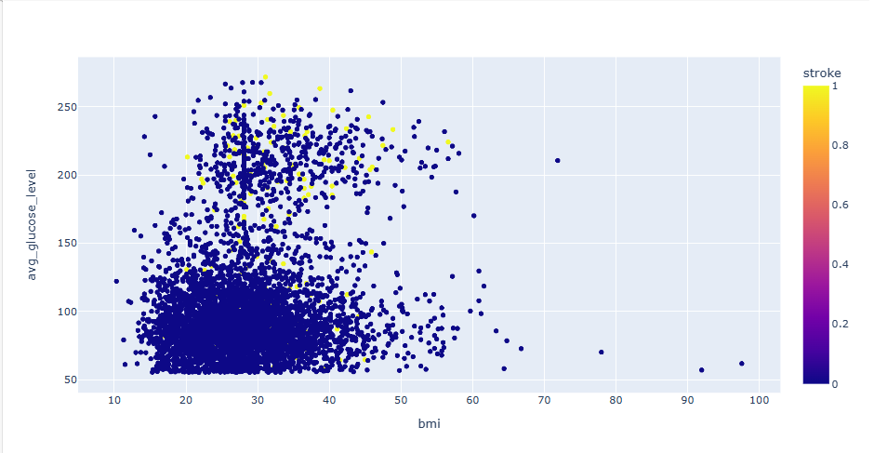
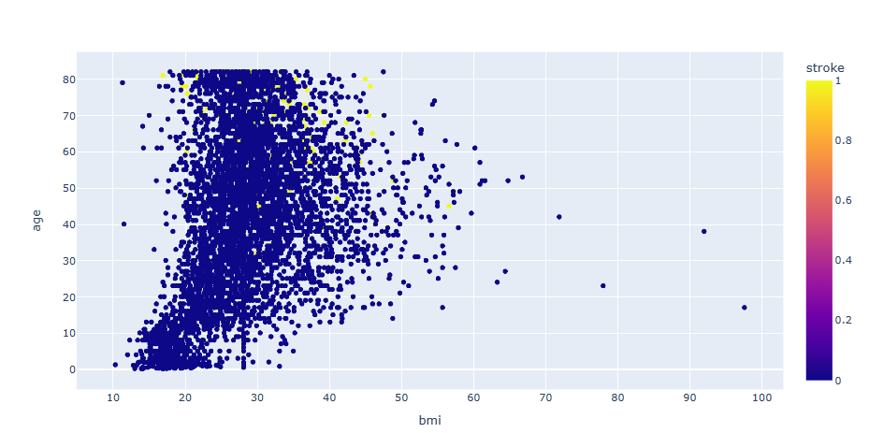
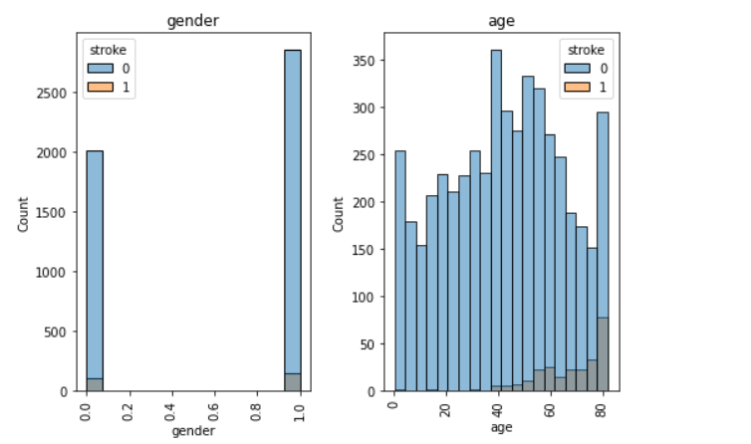
DATA VISUALIZATION
BMI index between 20- 50 and avg_glucose_level more than 100 got stroke.
BMI index between 15- 50 and age between 40-80 got stroke.
Age range of 40-80 have more chances of getting a stroke.
Females with no stroke are more in number than Males.

Slide 7
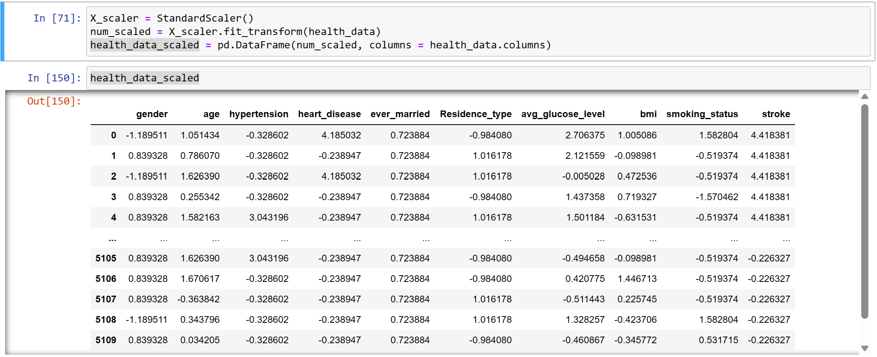
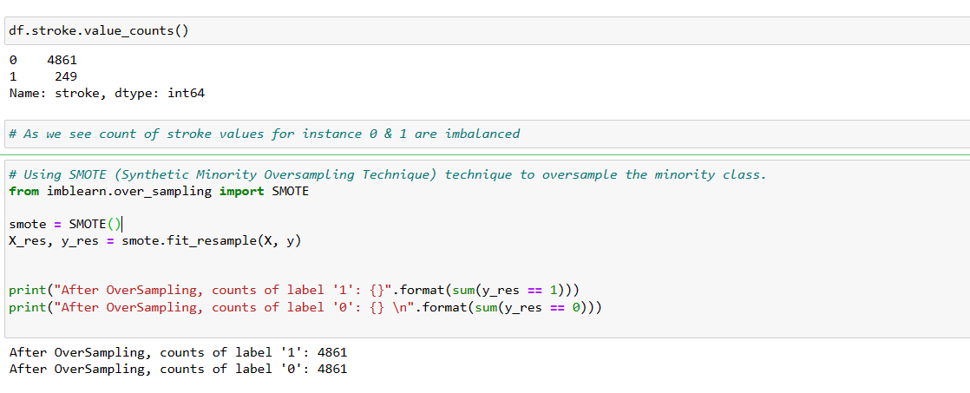
FEATURE ENGINEERING AND SELECTION
Scaled the data using StandardScaler
Balanced the target variable using SMOTE.

Slide 8
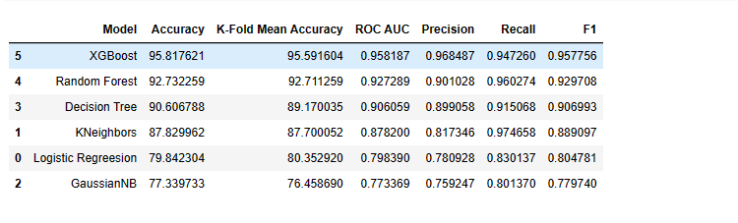
MODEL BUILDING AND EVALUATION
Spliting the data in 70:30 ratio.
Performed different classification algorithms.
RandomForest and XGBoost are giving better results.

Slide 9
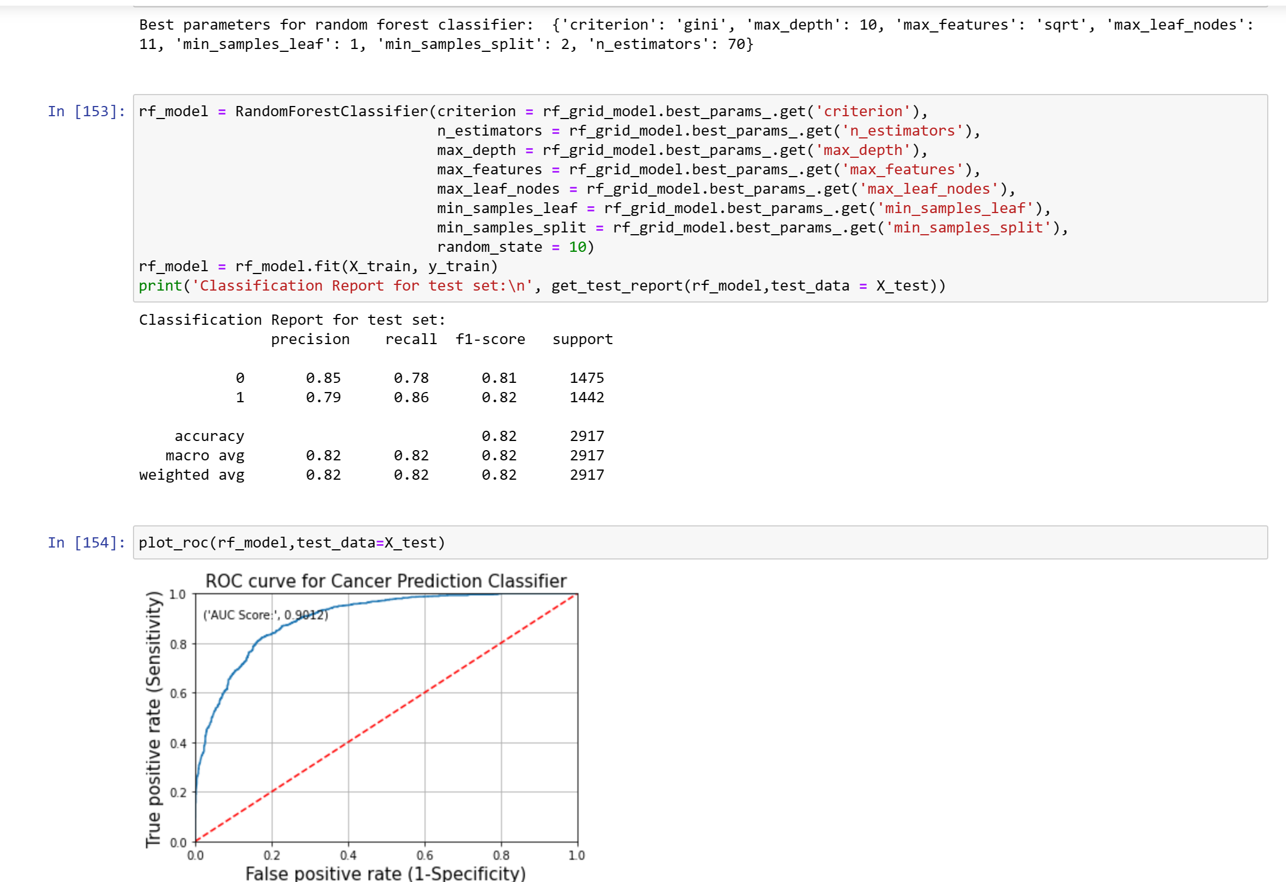
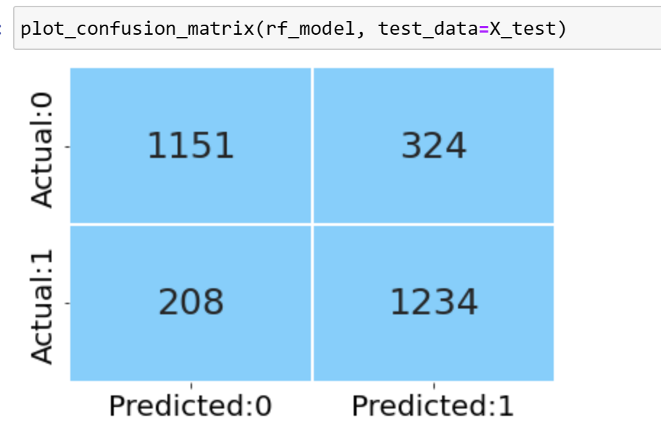
RESULTS AFTER HYPERPARAMETER TUNING
RandomForest Hyperparameter Using GridSearchCV
Splitting the data in 70:30 ratio.
Performed different classification algorithms.
RandomForest and XGBoost are giving better results.

Slide 10
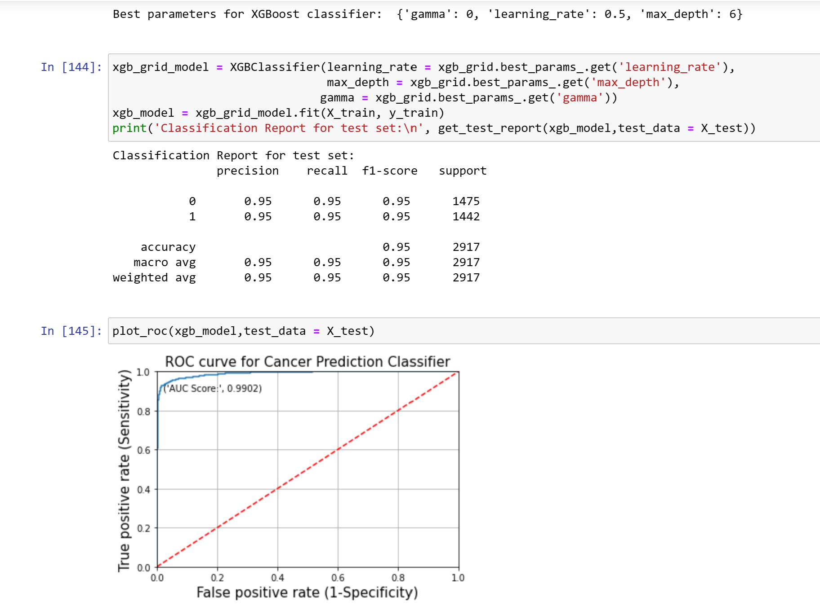
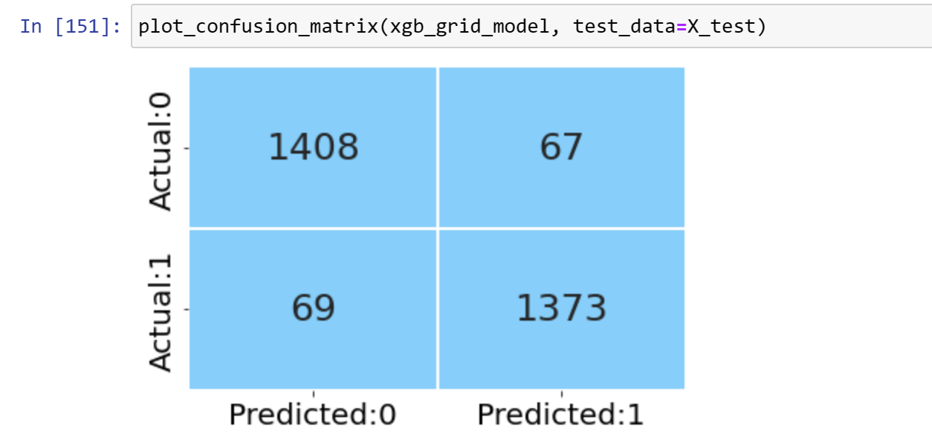
RESULTS AFTER HYPERPARAMETER TUNING
XGBoost

Slide 11
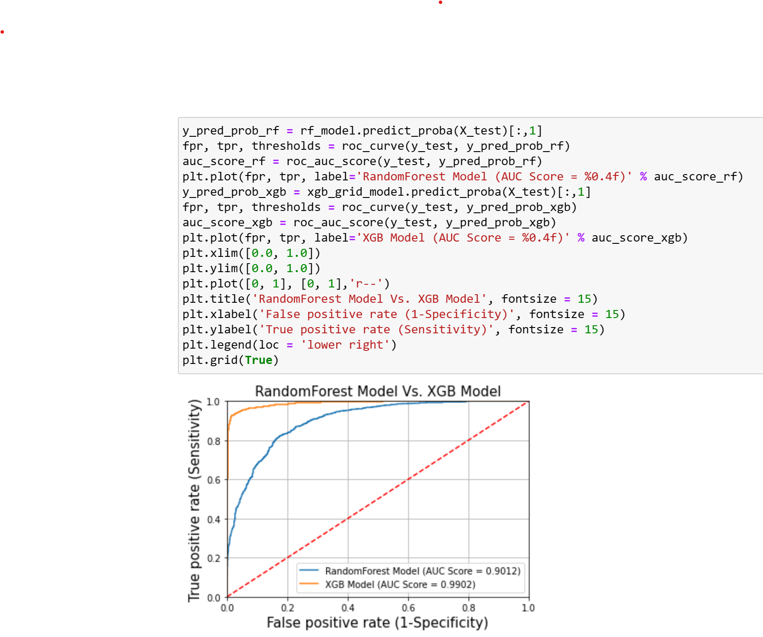
ROC COMPARISON BETWEEN RANDOMFOREST AND XGB
After Hyperparameter Tunning of Random Forest and XGB Model, AUC Score is High for XGB model. Hence XGB is the best model for our Given Dataset.

Slide 12
CONCLUSION
Based on the analysis of the stroke dataset, the XGBoost (XGB) model achieved an accuracy of 95% and an AUC (Area Under the Curve) value of 0.99. This indicates that the XGBoost model performed well in predicting stroke events using the provided dataset.
With an accuracy of 95%, the model correctly predicted the stroke outcome for 95% of the instances in the dataset. A higher accuracy suggests that the model is effective in distinguishing between stroke and non-stroke cases.
Precision, Recall, and F1-score: The precision, recall, and F1-score all have a value of 95%. These metrics provide insights into the model's performance in terms of correctly identifying positive (stroke) cases. A precision of 95% indicates that when the model predicts a stroke, it is correct 95% of the time. Similarly, a recall of 95% indicates that the model successfully identifies 95% of the actual stroke cases. The F1-score, which combines precision and recall, is also 95%, indicating a balanced performance in both aspects.
Additionally, the AUC value of 0.99 indicates that the XGBoost model has excellent discriminative ability. A higher AUC implies that the model has a strong ability to distinguish between positive and negative instances, with a minimal overlap between their predicted probabilities.
Overall, with the provided results, it can be concluded that the XGBoost model is a promising choice for predicting stroke events in this specific project.

Slide 13

THANK YOU!

